Slide 1
Computational Intelligence
Project Presentation
BREAST CANCER CLASSIFICATION :
ADAPTIVE NEURO FUZZY INFERENCE SYSTEM
Omoju A. Thomas
Department of Electrical and Computer Engineering
The University of Memphis, Memphis, TN USA 38152

Slide 2
US Mortality, 2001
Rank
Cause of Death
No. of deaths
% of all deaths
1. Heart Diseases 700,142 29.0
2. Cancer 553,768 22.9
3. Cerebrovascular diseases 163,538 6.8
4. Chronic lower respiratory diseases 123,013 5.1
5. Accidents (Unintentional injuries) 101,537 4.2
Source: US Mortality Public Use Data Tape 2001, National Center for Health Statistics, Centers for Disease Control and Prevention, 2003.
Notes:
Cancer accounts for nearly one-quarter of deaths in the United States, exceeded only by heart disease. In 2001, there were 553,768 cancer deaths in the US.

Slide 3
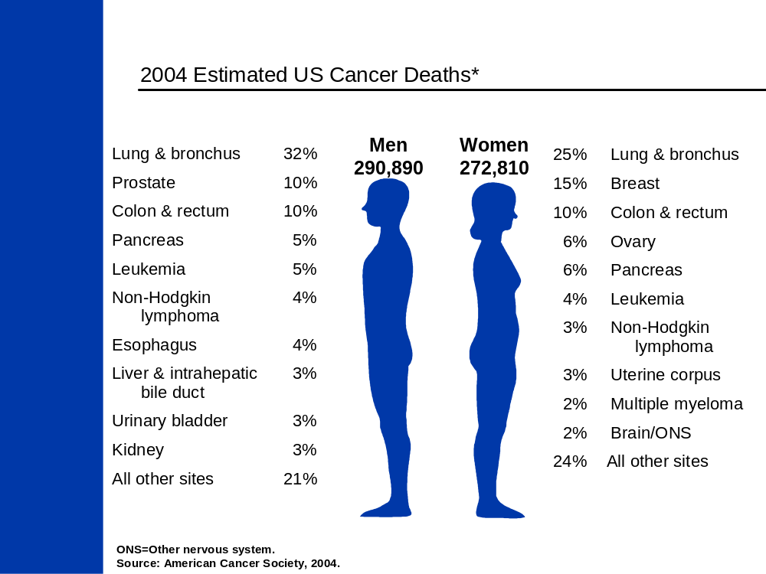
The most common fatal cancer in women, lung (25%), breast (15%), and colon & rectum (10%) are the leading sites of cancer death.

Slide 4
Breast Cancer Prediction : Motivation
40,921 are estimated to lose their lives to breast cancer.
Through early detection many lives can be saved.
FNA (Fine Needle Aspiration)
  Technique for diagnosis of palpable and mammographically detectable breast lesions

Slide 5
Wisconsin Breast Cancer Database
University of Wisconsin Hospitals, Madison
  Dr. William H. Wolberg
  Number of Instances: 699 (as of 15 July 1992)
  Number of Attributes: 10 plus the class attribute
  Attribute Information: (class attribute has been moved to last column)
  # Attribute Domain
  -- ----------------------------------------------------------------
  1. Sample code number id number
  2. Clump Thickness 1 – 10
  3. Uniformity of Cell Size 1 – 10
  4. Uniformity of Cell Shape 1 – 10
  5. Marginal Adhesion 1 – 10
  6. Single Epithelial Cell Size 1 – 10
  7. Bare Nuclei 1 – 10
  8. Bland Chromatin 1 – 10
  9. Normal Nucleoli 1 – 10
  10. Mitoses 1 – 10
  11. Class: (2 for benign, 4 for malignant)

Slide 6
Data: Preprocessing
A large percentage of the accuracy of any method performed on any data lies within the data itself.
  Delete rows with missing attributes
  Principal Components Analysis (PCA) was performed on the data
    Highlights the attributes that contain most information

Slide 7
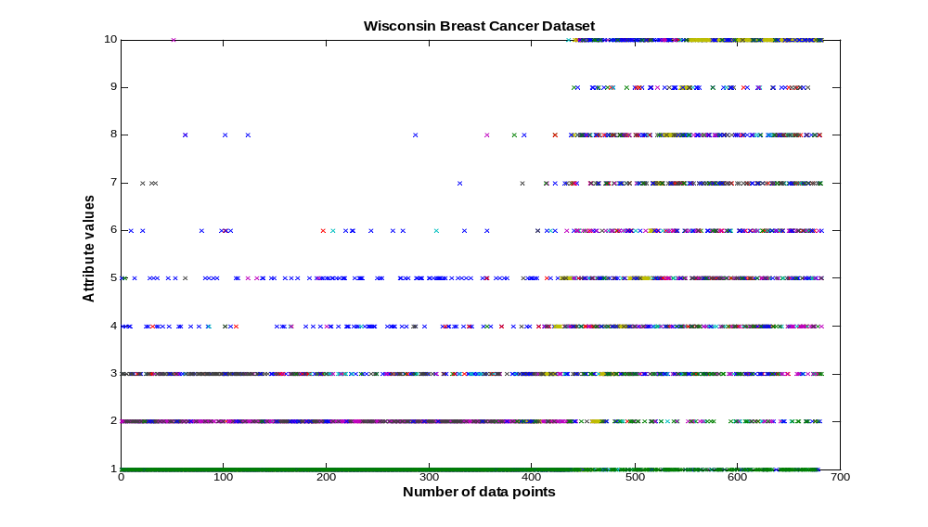

Slide 8
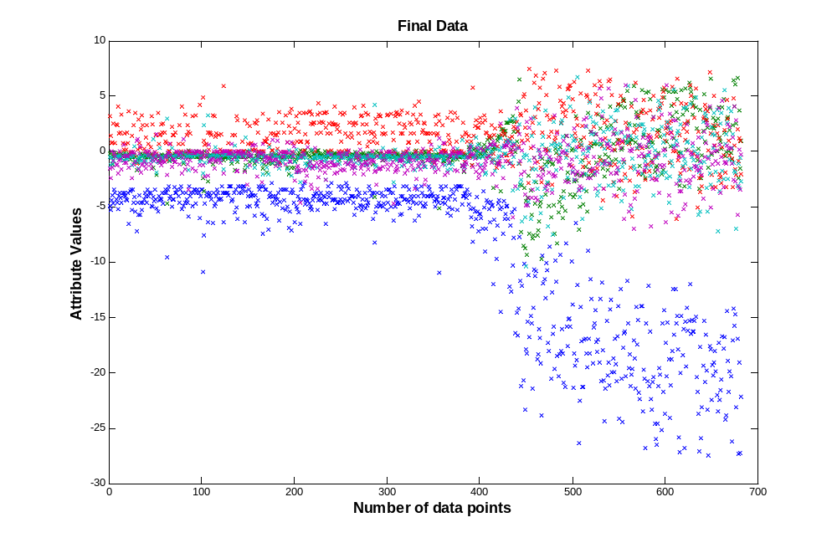

Slide 9
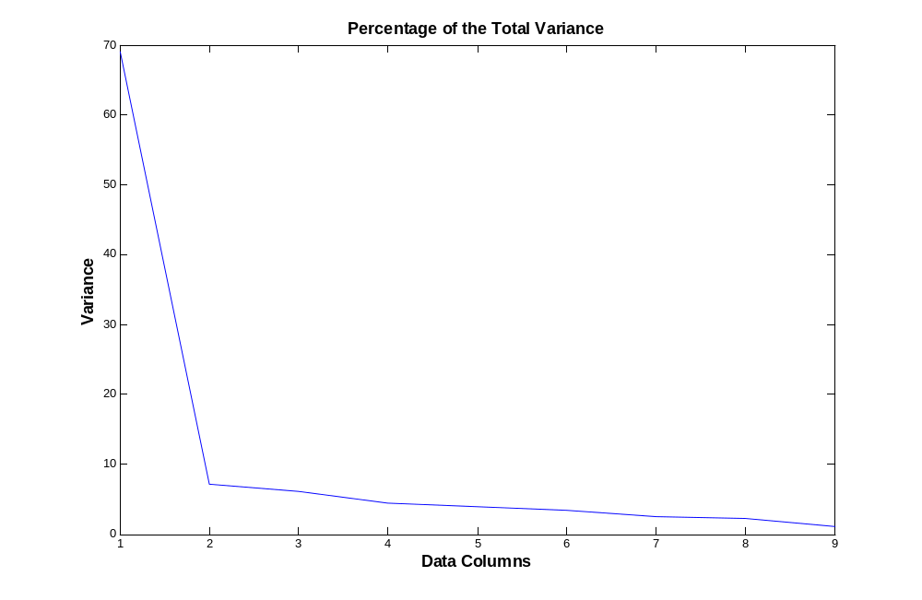

Slide 10
Data: Preprocessing
Result of Preprocessing:
Attribute No. | Percentage of Importance | Feature
1 | 69.0859 | Clump Thickness
2 | 7.1668 | Uniformity of Cell Size
3 | 6.0622 | Uniformity of Cell Shape
4 | 4.4344 | Marginal Adhesion
5 | 3.8973 | Single Epithelial Cell Size
6 | 3.4375 | Bare Nuclei
7 | 2.5304 | Bland Chromatin
8 | 2.2488 | Normal Nucleoli
9 | 1.1367 | Mitoses
The first five attributes were selected for training

Slide 11
Classification: ANFIS
Experiments
Reduce the dimensionality of the data.
Increase Epochs.
Train with the hybrid method
Train with back propagation

Slide 12
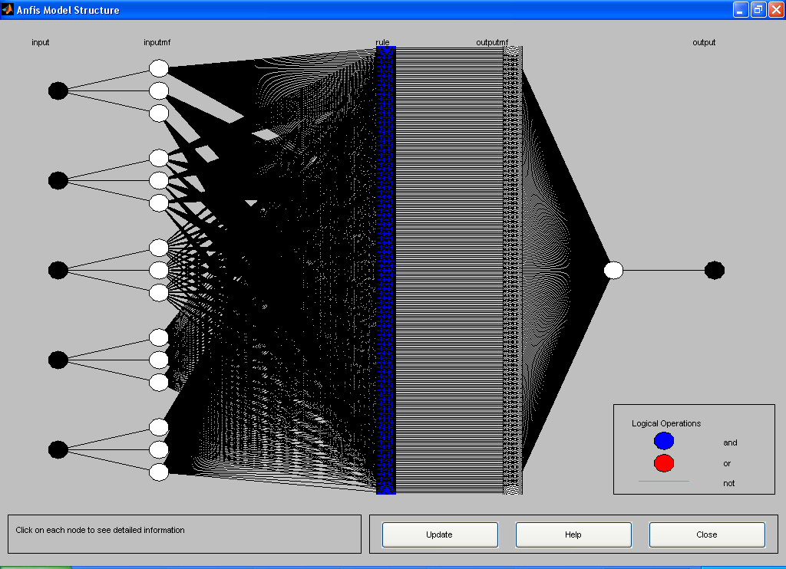
Experiment 1: Back propagation
A fuzzy inference system was generated using grid partitioning.
Number of Rules | 234
Number of Inputs | 5
Number of Outputs | 1
Number of membership function per input | 3
Type of membership function | gaussmf
And method | prod
Or method | probor
Defuzzification | wtaver
Training Method | Back Propagation
Epochs | 300
Training Data points | 230
Class 2 | 146
Class 4 | 82
Checking Data points | 221
Class 2 | 147
Class 4 | 73
Testing Data points | 231
Class 2 | 147
Class 4 | 82

Slide 13
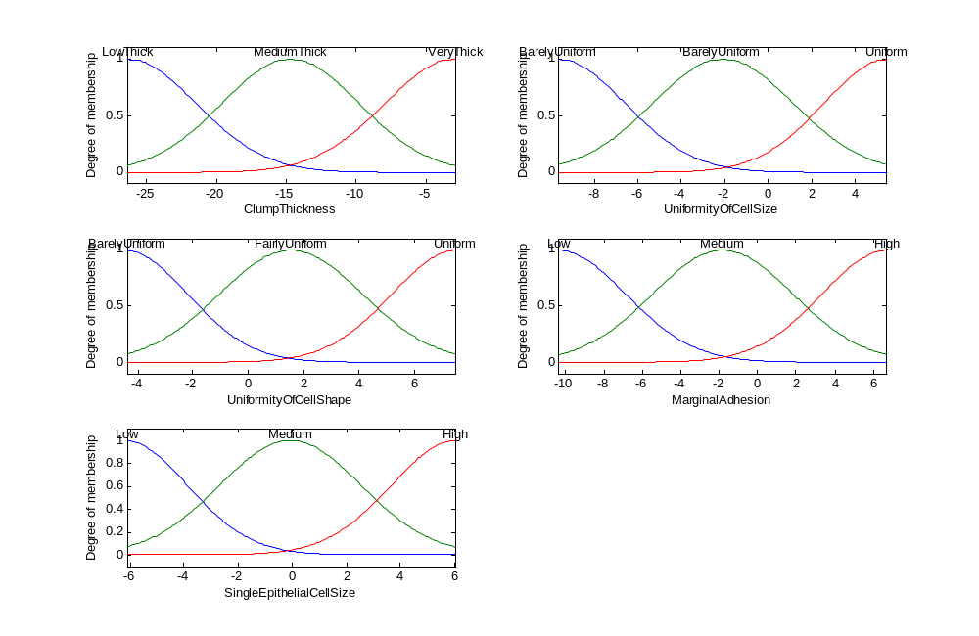

Slide 14
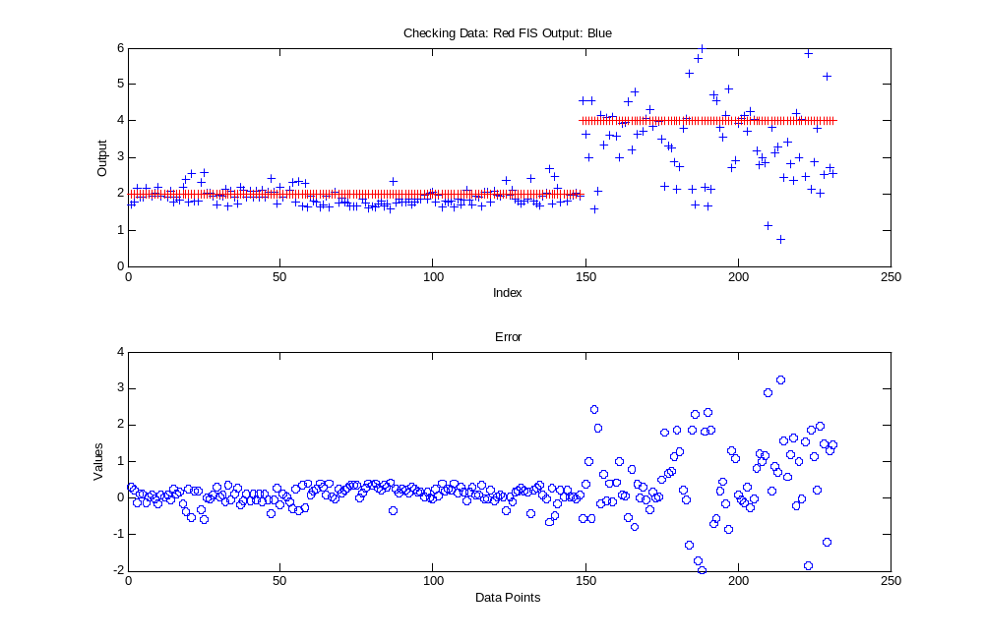

Slide 15
Experiment 1: Classification Error
Classification error of 6.9%
Classes | Correct | Incorrect
Benign | 145 | 1
Malignant | 71 | 12

Slide 16
Experiment 2: Normalize Data Z-Score
Number of Rules | 234
Number of Inputs | 5
Number of Outputs | 1
Number of membership function per input | 3
Type of membership function | gaussmf
And method | prod
Or method | probor
Defuzzification | wtaver
Training Method | Back Propagation
Epochs | 300
Training Data points | 230
Class 2 | 146
Class 4 | 82
Checking Data points | 221
Class 2 | 147
Class 4 | 73
Testing Data points | 231
Class 2 | 147

Slide 17
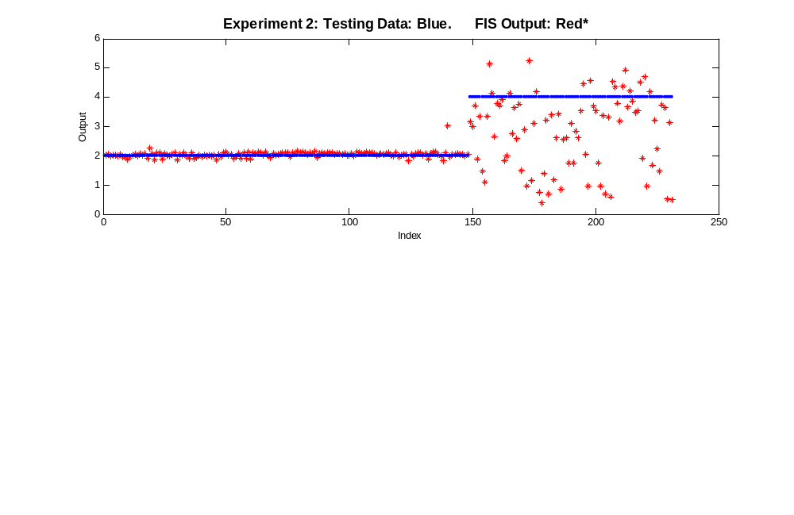
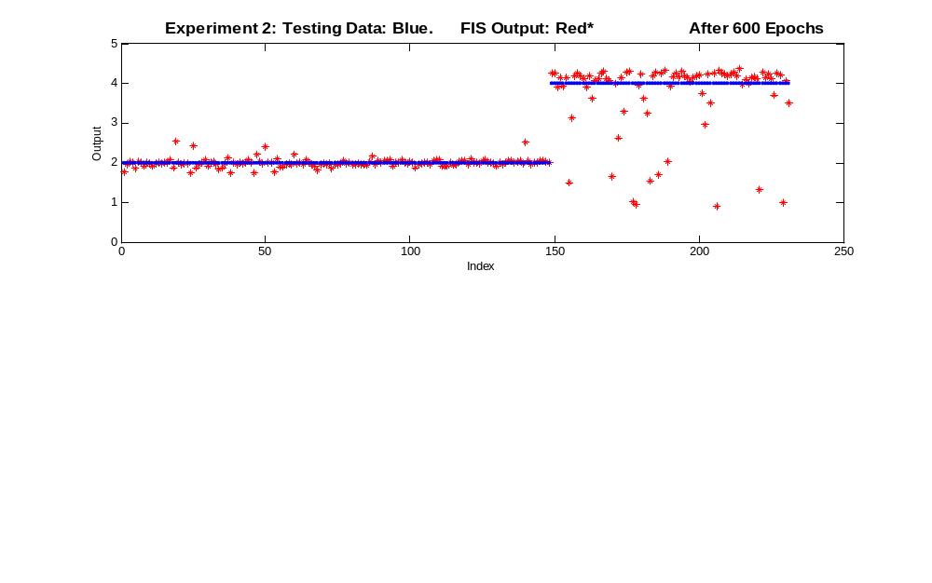

Slide 18
Experiment 2: Classification Error
Improved classification error from 3.4% to 0.8%
Class | Correct | Incorrect
Benign | 147 | 1
Malignant | 76 | 7
After 6oo Epochs
Benign | 146 | 2
Malignant | 83 | 1

Slide 19
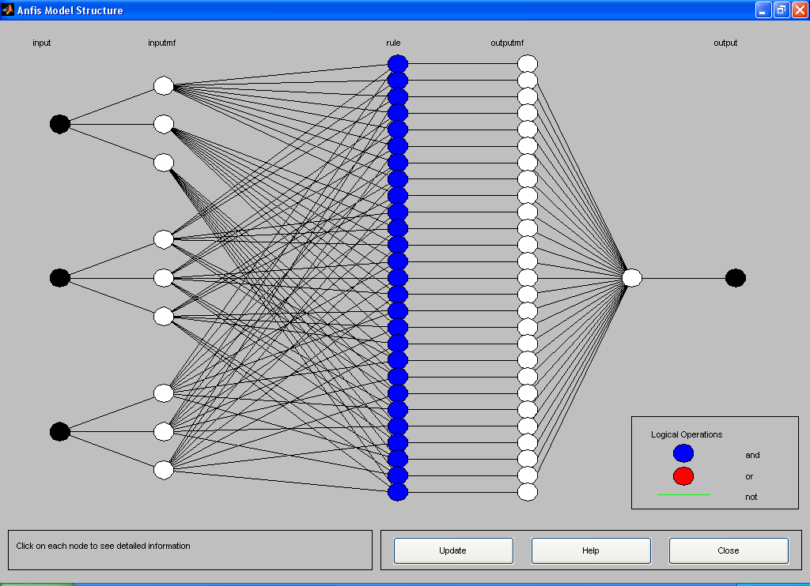
Experiment 3: Reduce dimensionality to 3
Number of Rules | 27
Number of Inputs | 3
Number of Outputs | 1
Number of membership function per input | 3
Type of membership function | gaussmf
Training Method | Back Prop
Epochs | 600
Training Data points | 230
Class 2 | 146
Class 4 | 82
Checking Data points | 221
Class 2 | 147
Class 4 | 73
Testing Data points | 231
Class 2 | 147
Epochs | 300

Slide 20
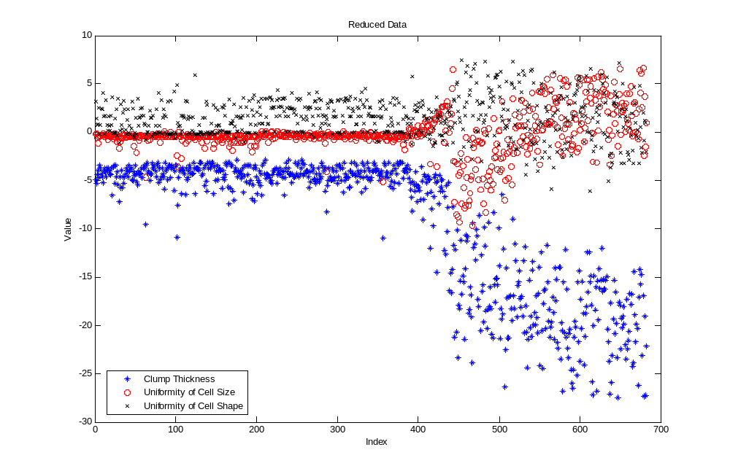

Slide 21
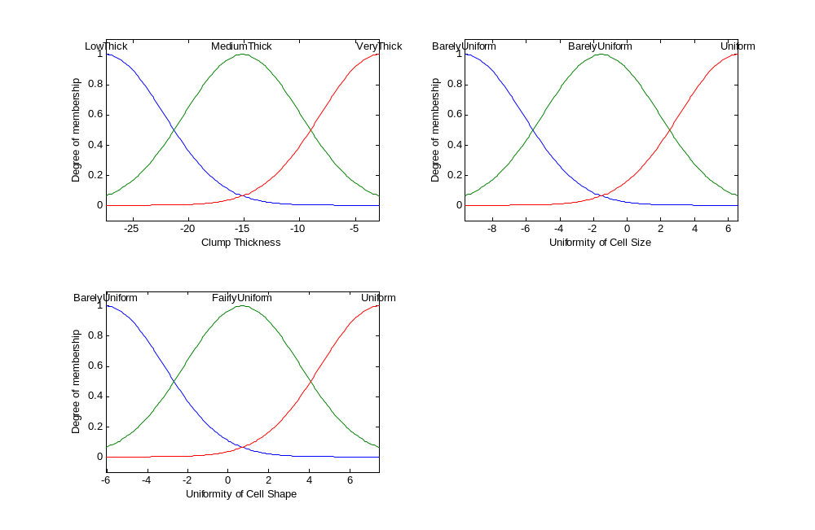

Slide 22
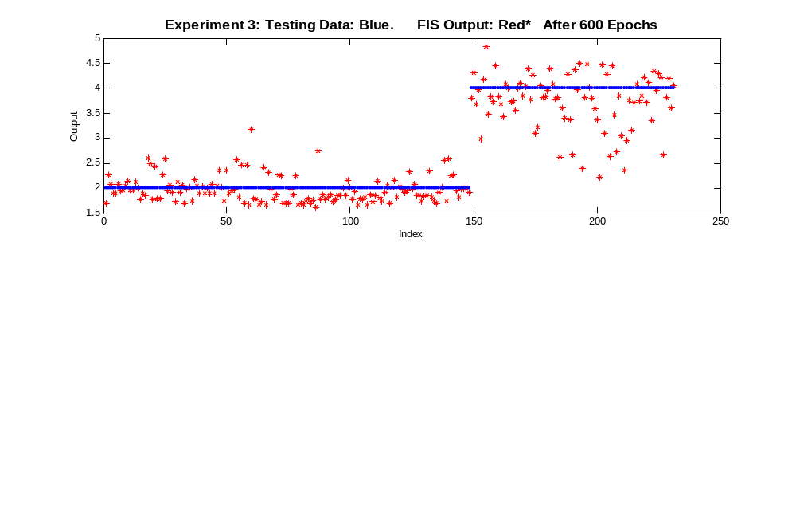

Slide 23
Experiment 3: Classification Error
Classification error of 3.47%
Class | Correct | Incorrect
Benign | 141 | 7
Malignant | 82 | 1

Slide 24
Experiment 4: Hybrid Method
Number of Rules | 27
Number of Inputs | 3
Number of Outputs | 1
Number of membership function per input | 3
Type of membership function | gaussmf
Training Method | hybrid
Epochs | 600
Training Data points | 230
Class 2 | 146
Class 4 | 82
Checking Data points | 221
Class 2 | 147
Class 4 | 73
Testing Data points | 231
Class 2 | 147
Epochs | 300

Slide 25
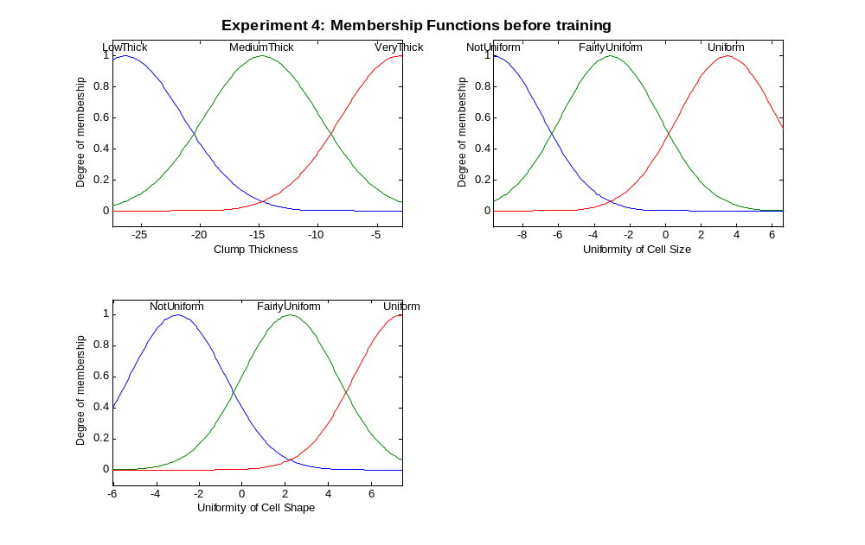

Slide 26
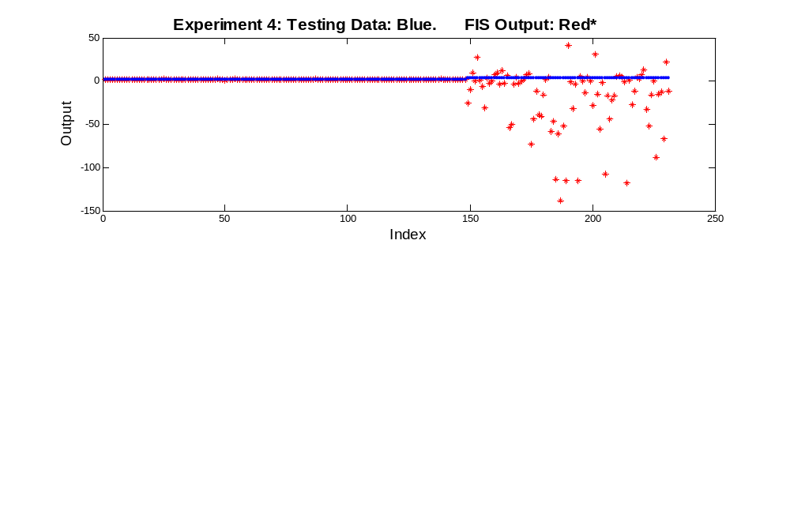

Slide 27
Experiment 4: Classification Error
Classification error of 8.658%
Class | Correct | Incorrect
Benign | 146 | 2
Malignant | 65 | 19

Slide 28
Final Conclusions
Exp. | Algorithm | Class. error | dimension | Epoch
1 | Back prop | 6.90 % | 5 | 300
2 | Back prop | 3.4632 % | 5 | 300
2 | Back prop | 0.8658 % | 5 | 600
3 | Back prop | 3.4632 % | 3 | 600
4 | Hybrid | 8.658 % | 3 | 10

